Slide 1
Collaboration Diagrams
Programming – Code Design & Data Structures

Slide 2
Contents
What Are Collaboration Diagrams
Why Use a Collaboration Diagram
Objects, Links, and Messages
Creation and Deletion of Objects

Slide 3
What Are Collaboration Diagrams
It provides another indication of the temporal order of communications
In a similar way to sequence diagrams
It emphasises the relationships among the objects, rather than the temporal order of messages
Whereas sequence diagrams emphasise the temporal order
It shows the same information as a sequence diagram

Slide 4
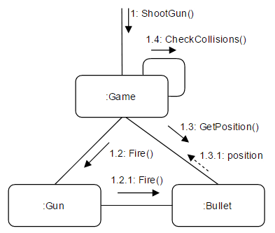
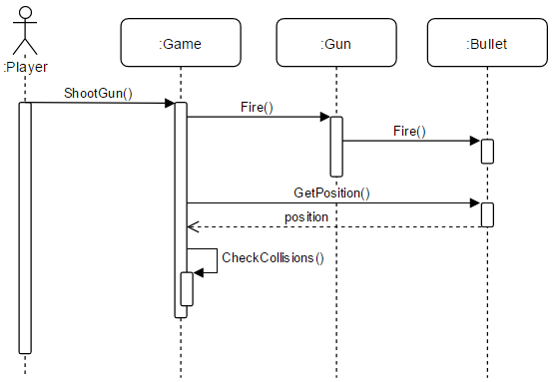
Collaboration Vs Sequence
Both of these diagrams show the same event

Slide 5
Why Use a Collaboration Diagram
Best suited to show the relationships between objects/classes that collaborate to perform a task
This information can be hard to determine from a sequence diagram
Collaboration diagrams can help you determine the accuracy of your class diagram
The relationships in a collaboration diagram map to the relationships in a class diagram

Slide 6
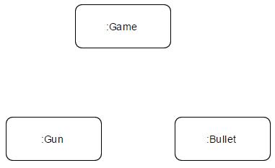
Objects
These are the same as the objects in a sequence diagram
In fact, they use the same notation for naming
You may see the names underlined. As with sequence diagrams, underlined names indicate a specific instance of a class
You often won’t need this level of detail

Slide 7
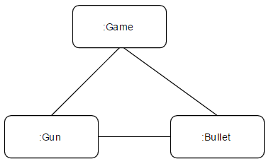
Links
Objects in a collaboration diagram are connected by links
These are what set collaboration diagrams apart from sequence diagrams
Links show the relationship between objects
Links represent the ability for objects to send messages to each other
They correspond to the associations in a class diagram

Slide 8
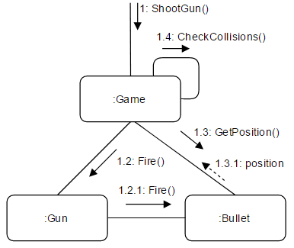
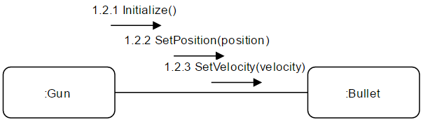
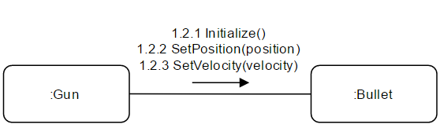
Messages
Shown as an arrow pointing from the caller to the receiver
Contain the message text, prefixed by a sequence number
The number indicates the order in which the messages are sent
The first message is numbered 1
If that message causes the receiving object to invoke other messages, those messages are numbered 1.1, 1.2, and so on
Each message icon can represent one or more messages

Slide 9
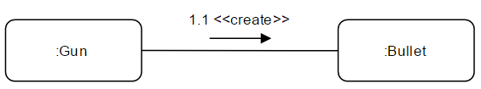
Creation and Deletion of Objects
Unlike sequence diagrams, collaboration diagrams don’t show an object’s lifeline
To indicate the lifespan of an object, you can use create and destroy messages

Slide 10
Summary
Collaboration diagrams are not used as often as sequence diagrams
But they can be very useful
They emphasise the relationships between objects and classes while displaying the temporal order of messages, like a sequence diagram
If you want the focus to be on the order messages are sent in your system, use a sequence diagram instead

Slide 11
Further Reading
McNeish, Kevin. 2017. UML Collaboration Diagrams. Code Magazine. [ONLINE] Available at: http://www.codemag.com/Article/0205051. [Accessed 12 April 2017]
Roger S. Pressman, 2014. Software Engineering: A Practitioner's Approach (Irwin Computer Science). 8 Edition. McGraw-Hill Education

